Slide 1

Welcome to
Mr. P.C. Wu
Mr. Paul Ang
Mr. Eric Tjandra
Ms. Barbara T. Suliani
Mr. Ronny B. Pelafoe

Slide 2


Maju Depot & Logistics Operated by : PT. Samudera Pacific Maju
Start operating in March 2004 under management of P.T. Samudera Pacific Maju
With well equipped tools, technology & staff , including IICL certified personnel
We ensure complete container care.

Slide 3
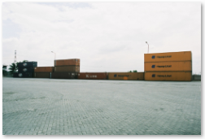

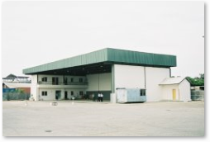
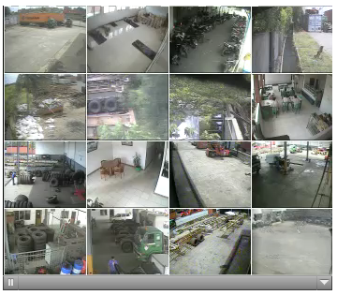
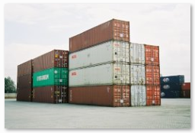
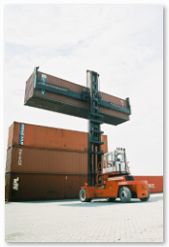
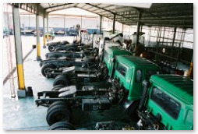
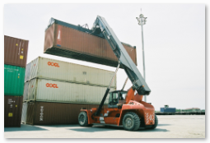
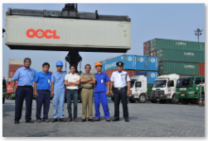
Services & Facilities
Container Depot
Reefer, Repair & Washing
Space Availability 4500 TEUs
Trucking & Chassis
Reach Stacker, Side Loader, Forklift
24/7 Operations, Security, CCTV
Power Supply 296.000 Watts
Genset 147.000 Watts

Slide 4
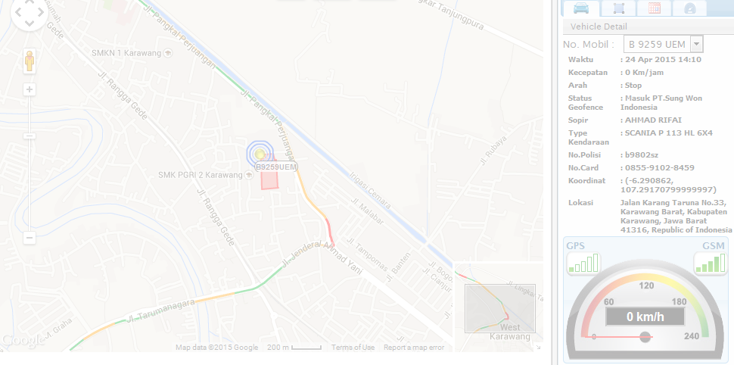



We exclusively provide five unit trucks equipped with GPS to support OOCL Logistics as our commitment to always give the best services to our customers

Slide 5
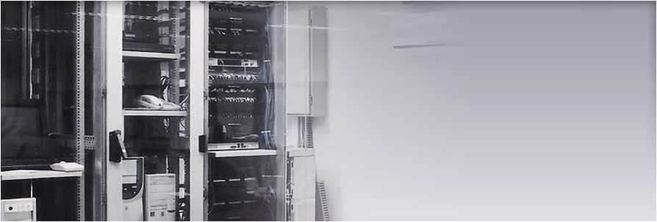
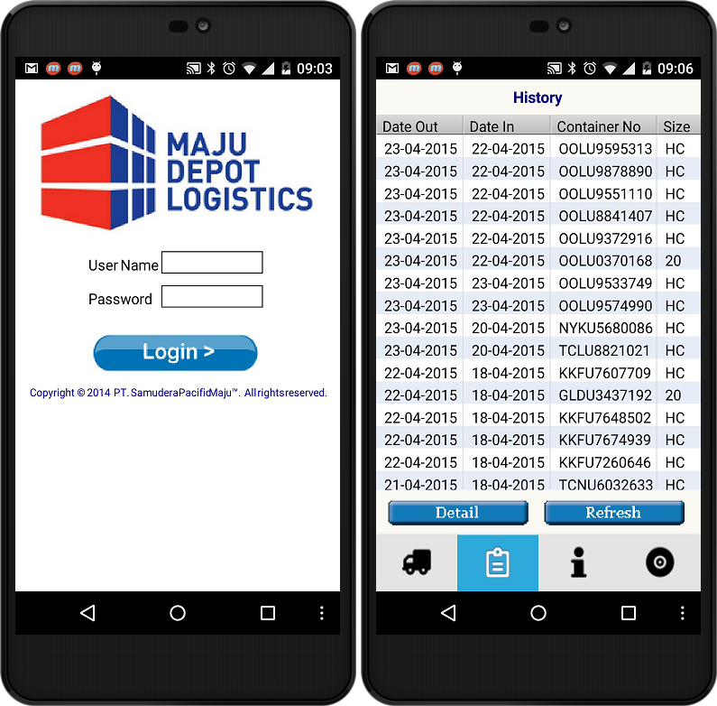
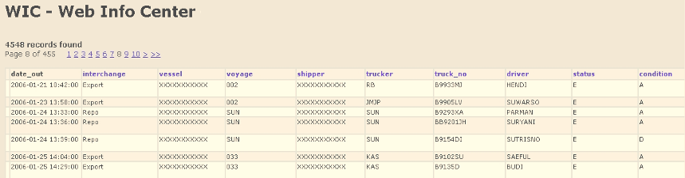
Information Technology
MDL ongoing improvements to its IT are focused on
customers service & efficiency. MDL Depot System (MDS), Web Info Centre (WIC), Mobile Access,
and other tailored report will be develop upon request.

Slide 6
ORGANIZATION CHART
Peter Adam
Managing Director
Sarwan Kumar
Director
Saman Sjukur
Information Tech
Suryanto
Operation
Richard Raranta
HRD/GA/Asset
Suyadi
Security
Ishak J. Abidin
Kirisna Kunalen
Heavy Equip.
Tri
Prio
Hariyono
Cont. Cleaning
Jajang Isman
Adm. Staff
Widiawati Yusuf
Maintenance
Sumaryanto
Sugito H.
Hadi S.
Darsono Agus T Kusaeri
Dian P Hermawan
Edi Suyatno
Zaenal Aripin
Imam S Bakhri
Dedi Supriatna
Lasimin
Kusno
Damin
Yard Operation
Teguh
Dedi
Office Boy
Iman Kusdin
Subur, Minah

Slide 7
Thank You

